Slide 1
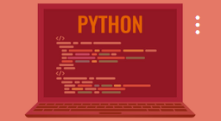

CWCT 140
Professor David Lieberman
dlieberman@ivytech.edu

Slide 2
Agenda
Modules
Packages
Math, Sys (dir)
Command Line Parameters
NumPy
Matplotlib
PIP
Lab / Prog Assignment

Slide 3
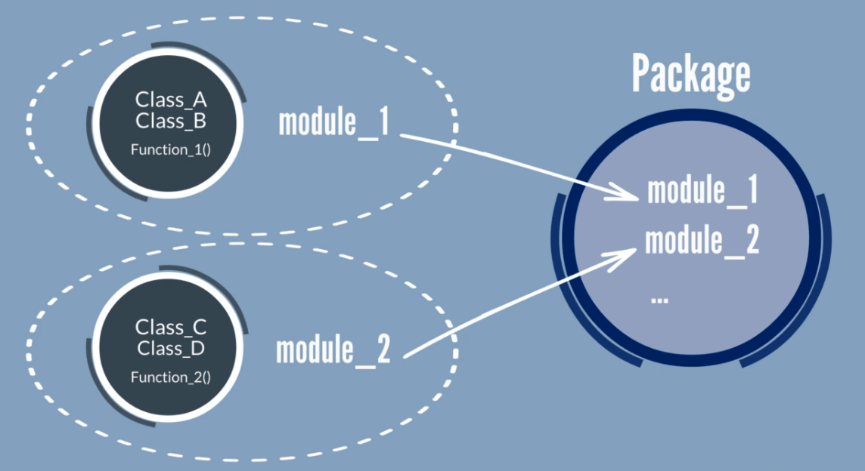
Python Modules

Slide 4
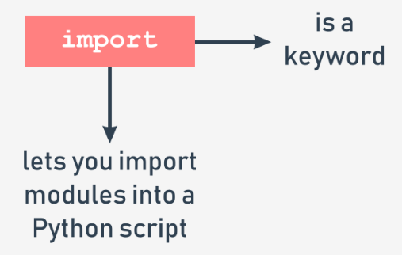
Import Modules
import math
import matplotlib.pyplot as plt

Slide 5
Useful Modules
math, sys (dir)
numpy - arrays
matplotlib - graphs
csv – manage CSV files
requests – web interface
BeautifulSoup – HTML parsing
Pandas - data analysis

Slide 6
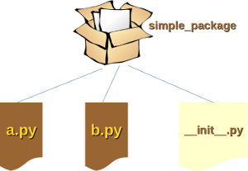
Python Packages

Slide 7
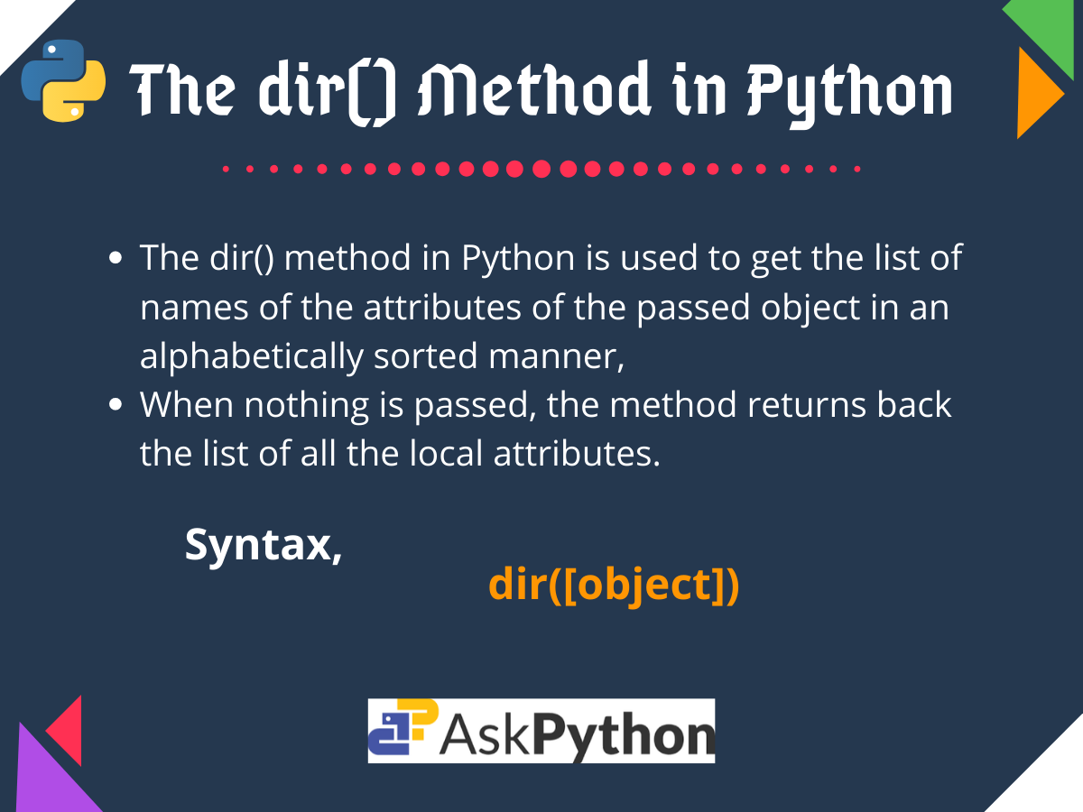
Dir function

Slide 8
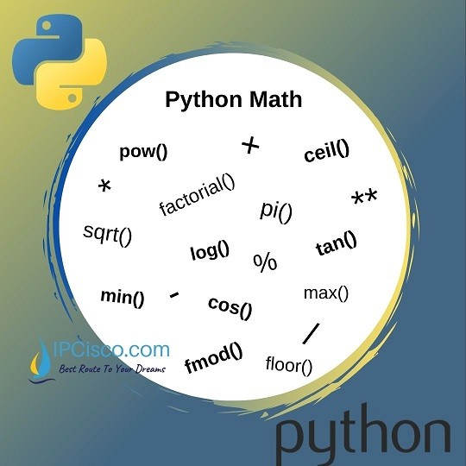
Math Module

Slide 9
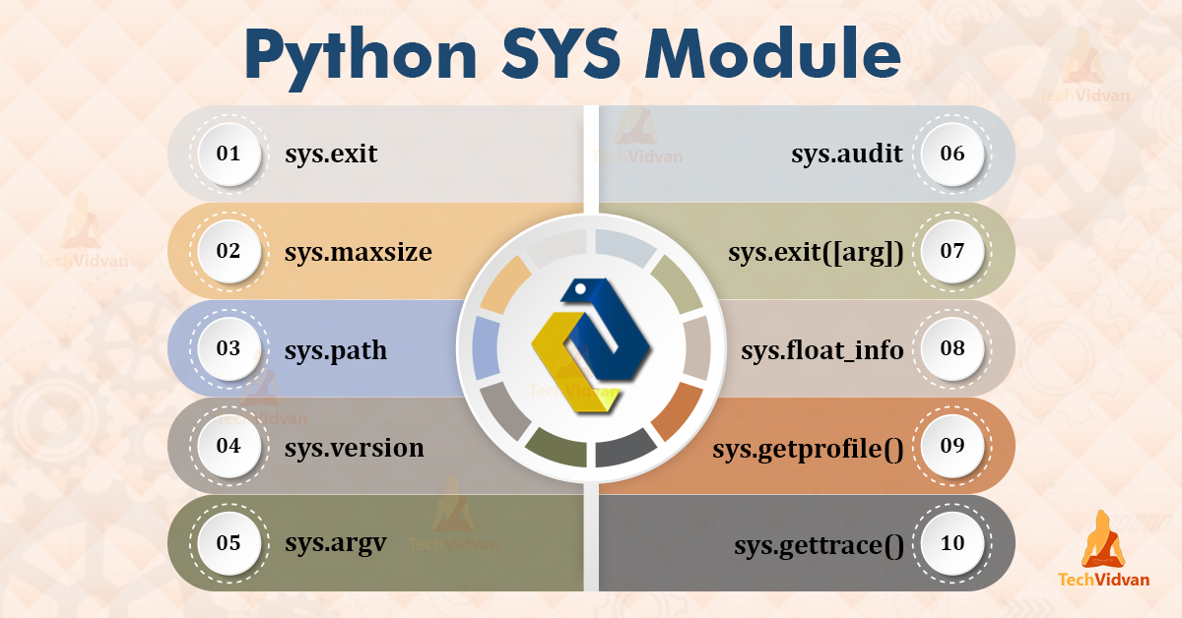
Sys Module

Slide 10
Arrays vs Lists
Lists manage data dynamically. Arrays pre-allocate space.
Arrays need to be declared. Lists don't, since they are built into Python..
Arrays can store data very compactly
Arrays are great for numerical operations; lists cannot directly handle math operations.

Slide 11
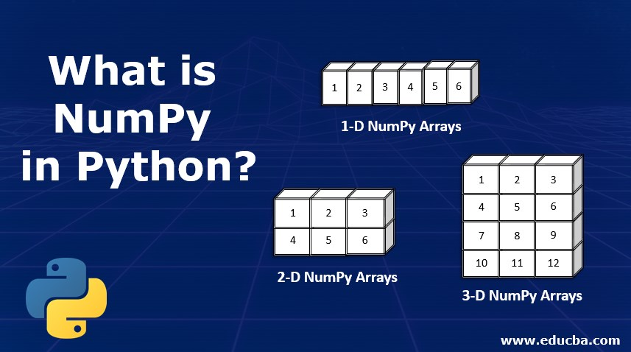
NumPy Module
NumPy is used for working with arrays.
NumPy is short for "Numerical Python".

Slide 12
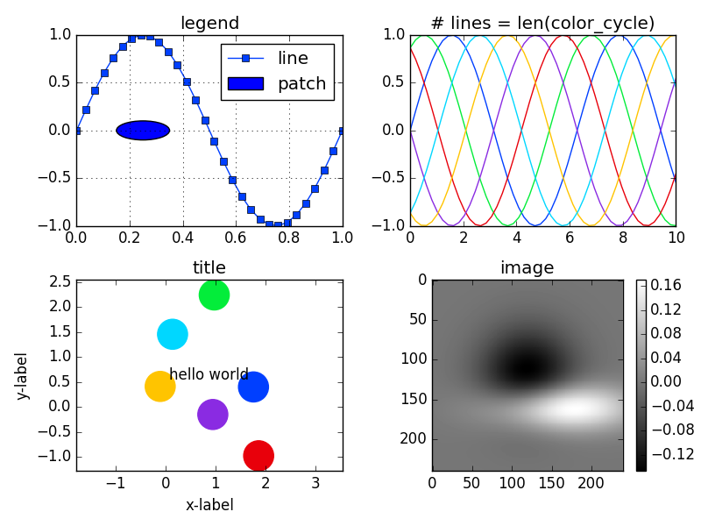
Matplotlib Pyplot
import matplotlib.pyplot as plt

Slide 13
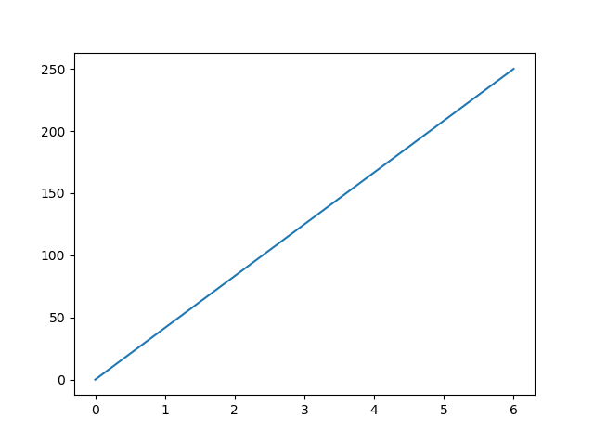
Matplotlib Pyplot Example
import matplotlib.pyplot as plt
import numpy as np
xpoints = np.array([0, 6])
ypoints = np.array([0, 250])
plt.plot(xpoints, ypoints)
plt.show()

Slide 14
NumPy Arrays
import numpy as np
import matplotlib.pyplot as plt
import math
xlist = []
ylist = []
#Create Sine Wave
for i in range(100):
rad = (2.0 * math.pi * i) / 100.0
xlist.append(i)
ylist.append(math.sin(rad))
xpoints = np.array(xlist)
ypoints = np.array(ylist)
plt.plot(xpoints, ypoints)
plt.show()

Slide 15
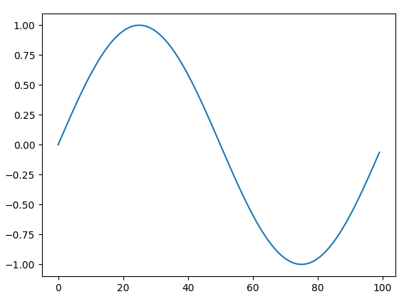
NumPy Arrays

Slide 16
Command Line Arguments
import sys
myList = sys.argv[:]
print("Command line list:", myList)
print("Argument 1:", myList[0])
print("Argument 2:", myList[1])

Slide 17
PIP – Package Installer
https://www.w3schools.com/python/python_pip.asp

Slide 18
Programming Assignment
With all program submissions you need to include screenshots illustrating your programs ran successfully.
All program submissions require a header comment containing your name, course, date, program name, and a description of the program.

Slide 19
Assignment
Write a program that provides a menu-driven digital contact list to the user. Create a dictionary with four or five contacts (names and numbers). The user should be able to add/update/delete entries to the contact list.
The user should then be able to
retrieve the phone number for a given contact name
add new contacts
delete contacts
update the phone number for a contact.
Lab exercise – read and update the contact list from/to a CSV file

Slide 20
Pseudo-Code
# pseudo code for phone directory application
# subroutines here
# list contacts
# add contact
# update contact
# delete contact
# ** MAIN PROGRAM **
# while not exiting...
# show menu
# 1 - Show contact list
# 2 - Add to contact list
# 3 - Update contact phone number
# 4 - Delete contact
# 0 - Exit
# accept command input
# decode command and call appropriate function

